Slide 1

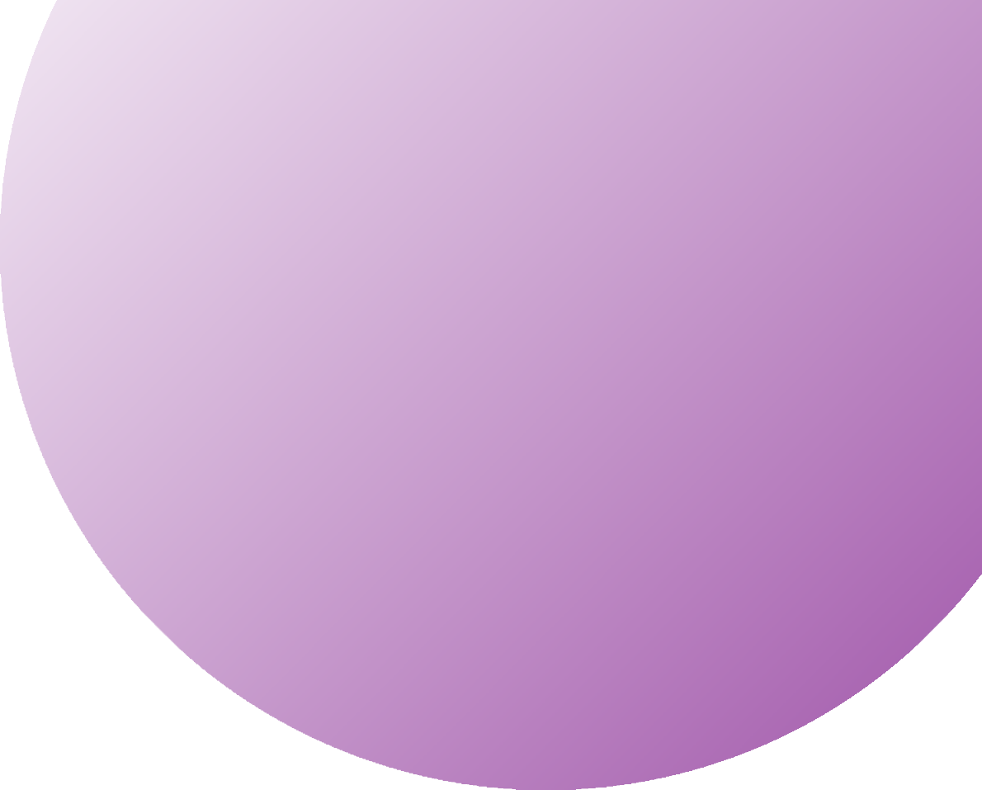
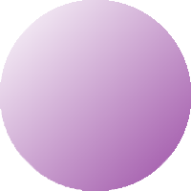
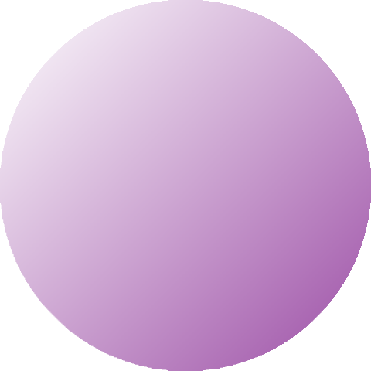
CARTOONIFY
IMAGE

Slide 2


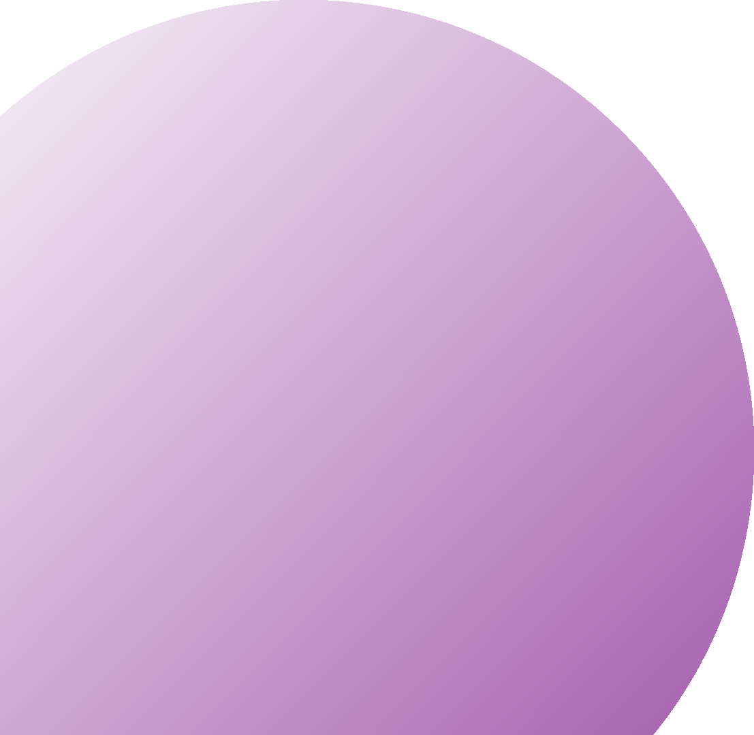
TABLE OF CONTENT
INTRODUCTION
REQUIREMENTS OPEN CV METHODOLOGY
EXPECTED OUTCOMES REFERENCES

Slide 3

INTRODUCTION
We will build one interesting application that will cartoonify the image provided to it. To build this cartoonifyer
application we will use python and OpenCV. This is one of the exciting and thrilling applications of Machine Learning. While building this application we will also see how to use libraries like easygui, Tkinter, and all. Here you have to select the image and then the application will convert that image into its cartoon form. Mainly, we build this application using OpenCV and python as the programming languages.

Slide 4
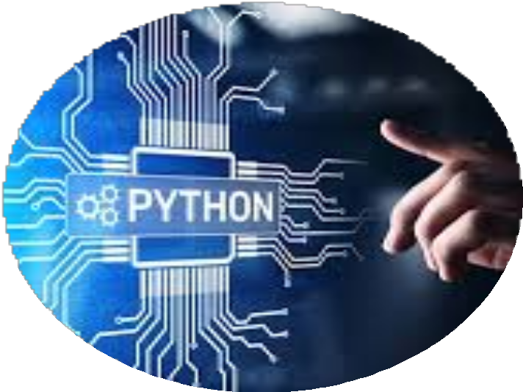
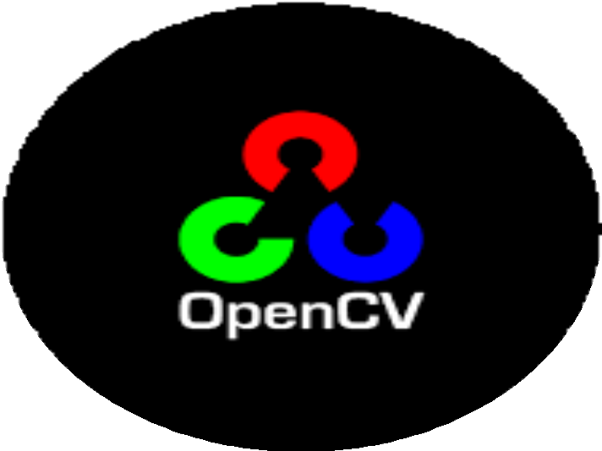
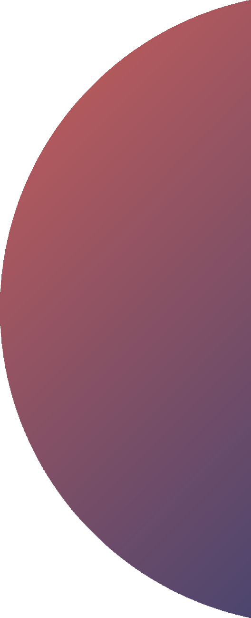

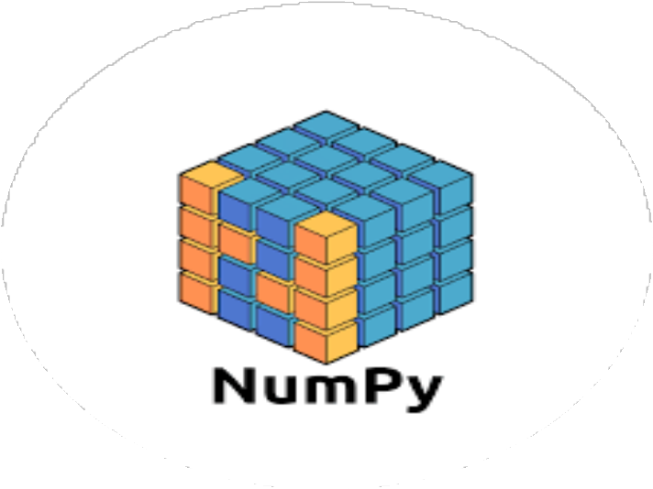
REQUIREMENTS
01
Python: We use python as a programming language for building the application.
02
OpneCV: We use OpneCV for image processing.
03
Numpy: Mainly NumPy is used for dealing with arrays. Here the images that we use are stored in the form of arrays. So for that, we use NumPy.
.

Slide 5
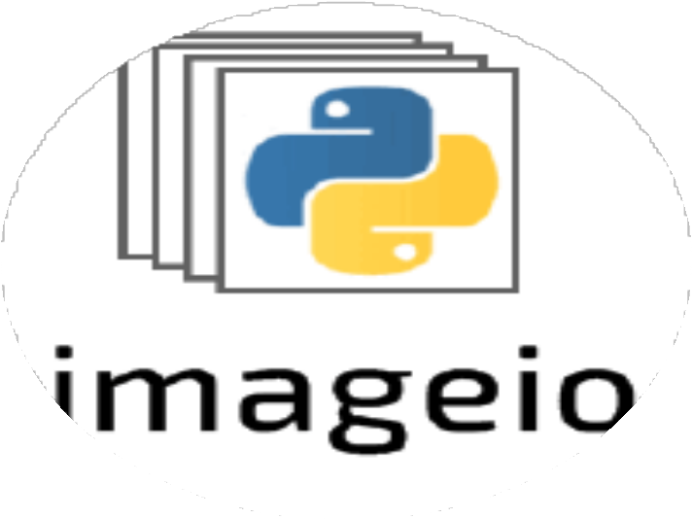
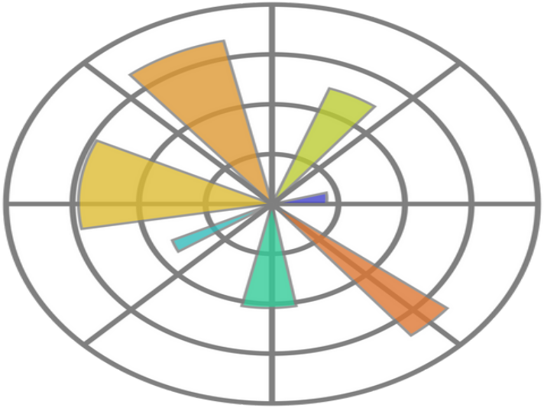
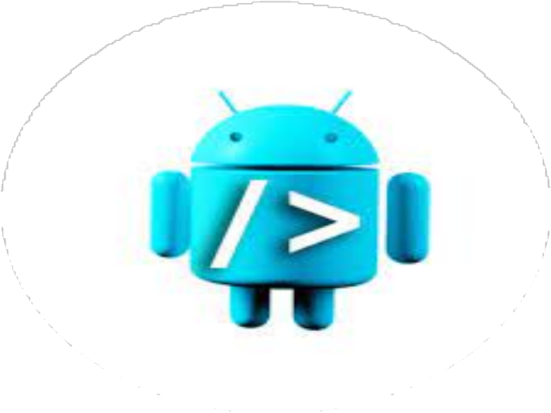
REQUIREMENTS
04
Imageio: Imageio is a python library that reads and writes the images.
05
Matplotlib: Matplotlib is used for visualization purposes. Here we plot the images using matplotlib.
06
easygui: easygui is a module used for GUI programming in python. In our application easygui is used to open the file box to upload images from the local system.

Slide 6

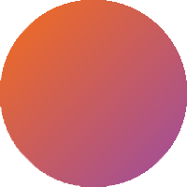

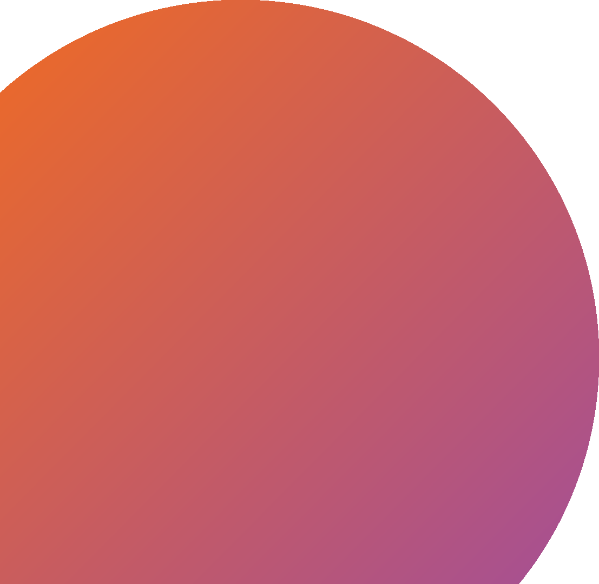
OPEN CV
OpenCV is an open-source library in python that is used mainly for computer vision tasks in the areas of machine learning and artificial intelligence. Nowadays, openCV is
playing a major role in the field of technology. Using OpenCV we can process images and videos for some tasks like object detection, face detection, object tracking, and all.
OpenCV has c, c++, java, and python interfaces and it supports all kinds of systems such as Windows, Linux,
Android, Mac OS, IoS, and all…

Slide 7
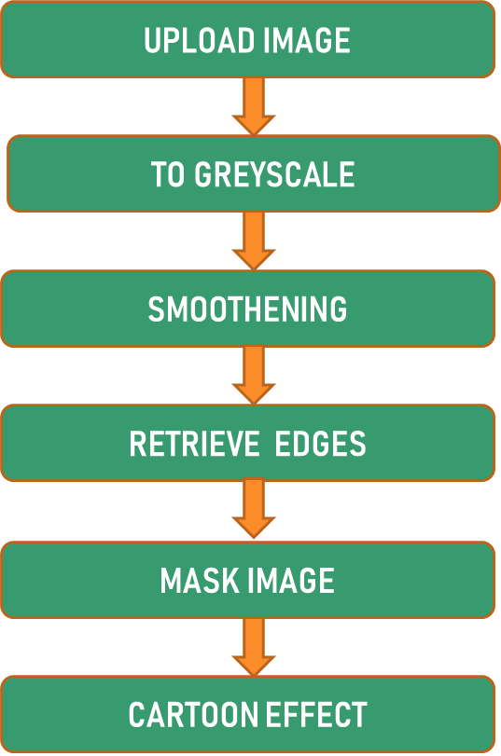
METHODOLOGY

Slide 8

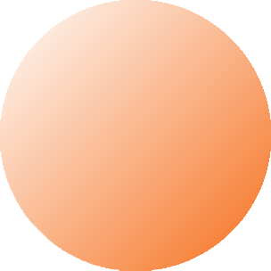


METHODOLOGY
USING EASYGUI
First of all using easygui, we will upload the image, and then the image is converted to a greyscale image.
SMOOTHENING IMAGE
. In this color of the image is smoothened to give the cartoon look
01
02
RETREIVE EDGES
we retrieve the edges and then highlight them in the final image.
MASK IMAGE
. In this, we use the bilateral filter with removes the noise and smoothen it to some extent. Now the final step is giving the cartoon effect. To the image which we got in the previous step, we combine our two important steps and finally give a mask- edged image that looks like a cartoon image.
03
04

Slide 9
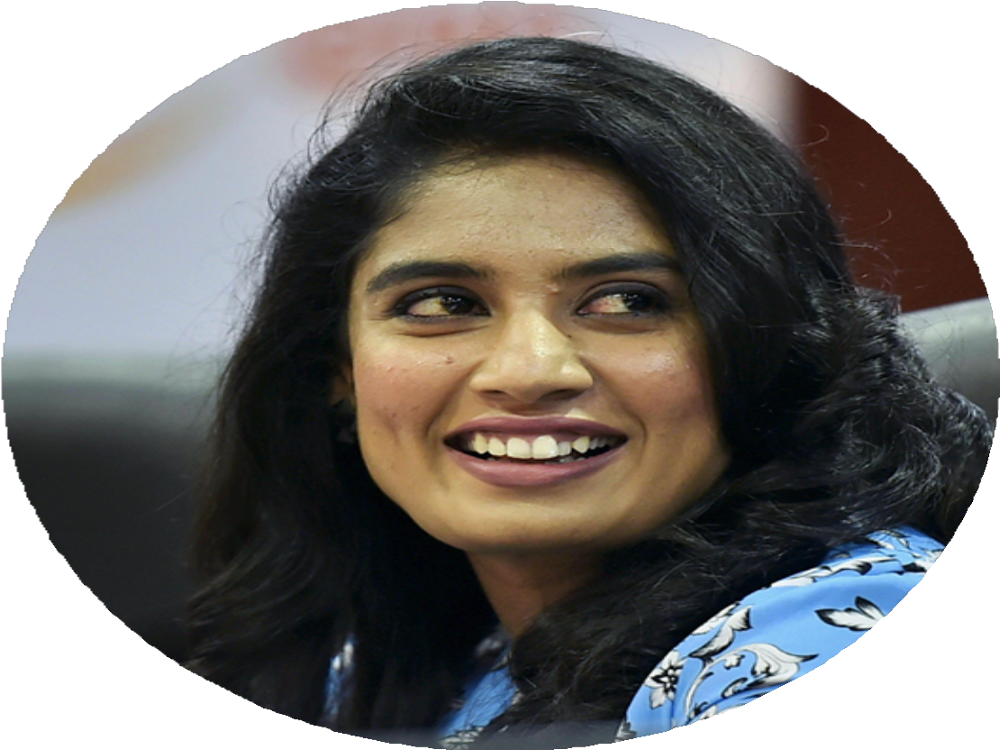
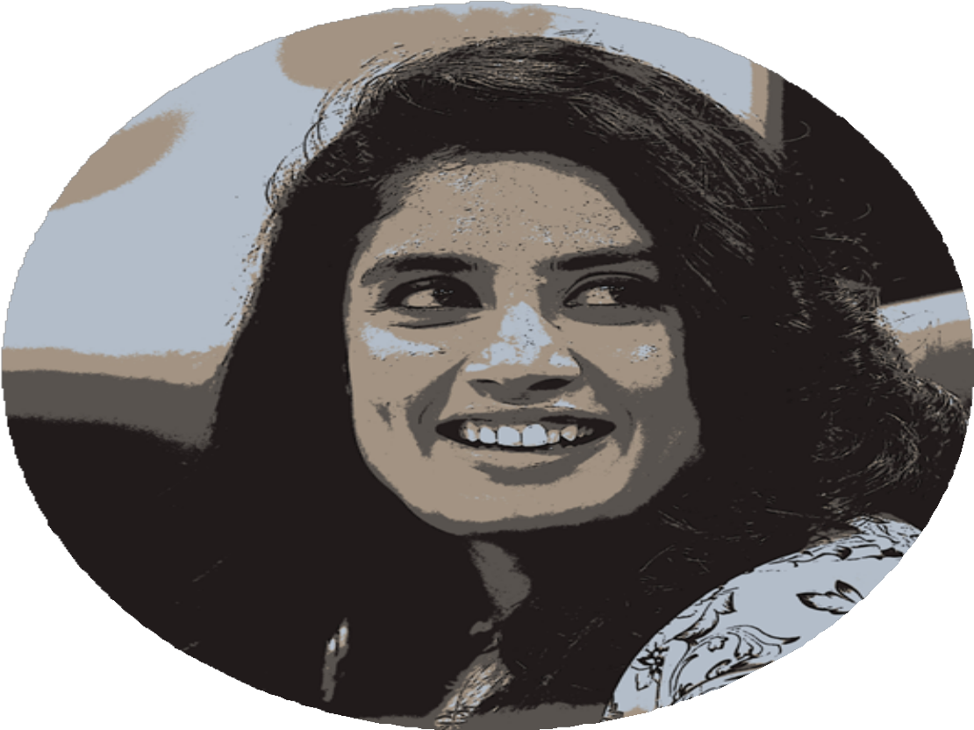
NORMAL IMAGE TO CARTOONED IMAGE

Slide 10
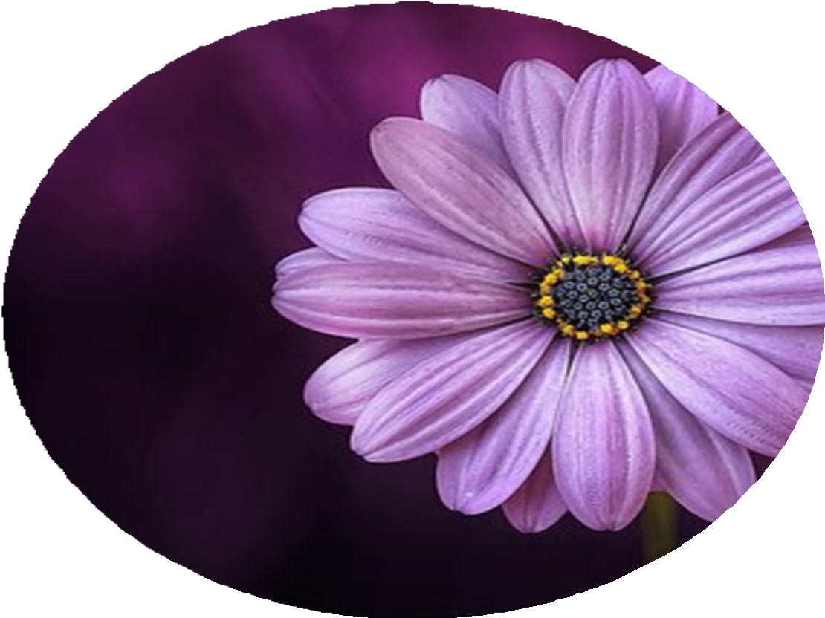
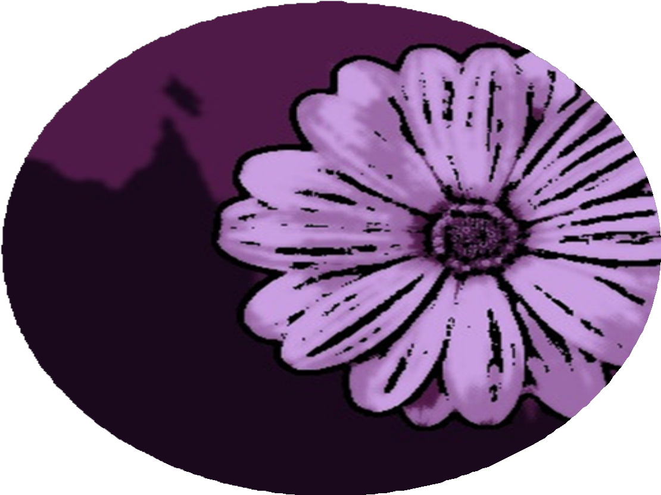
NORMAL IMAGE TO CARTOONED IMAGE

Slide 11
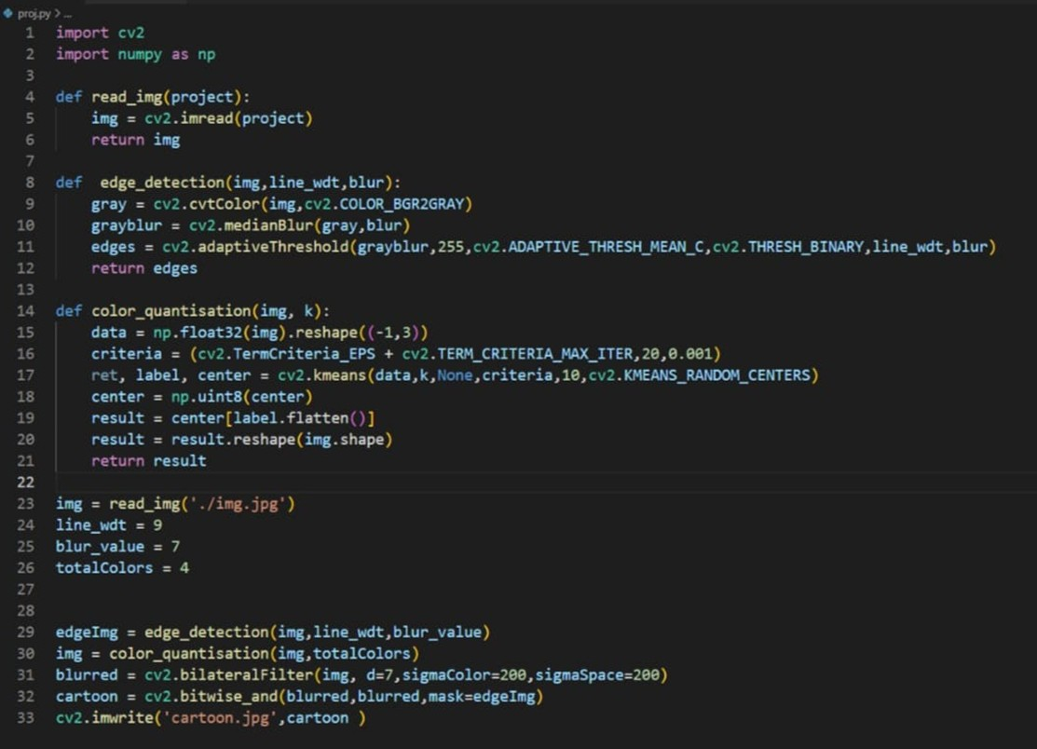
CODE SNIPPETS

Slide 12
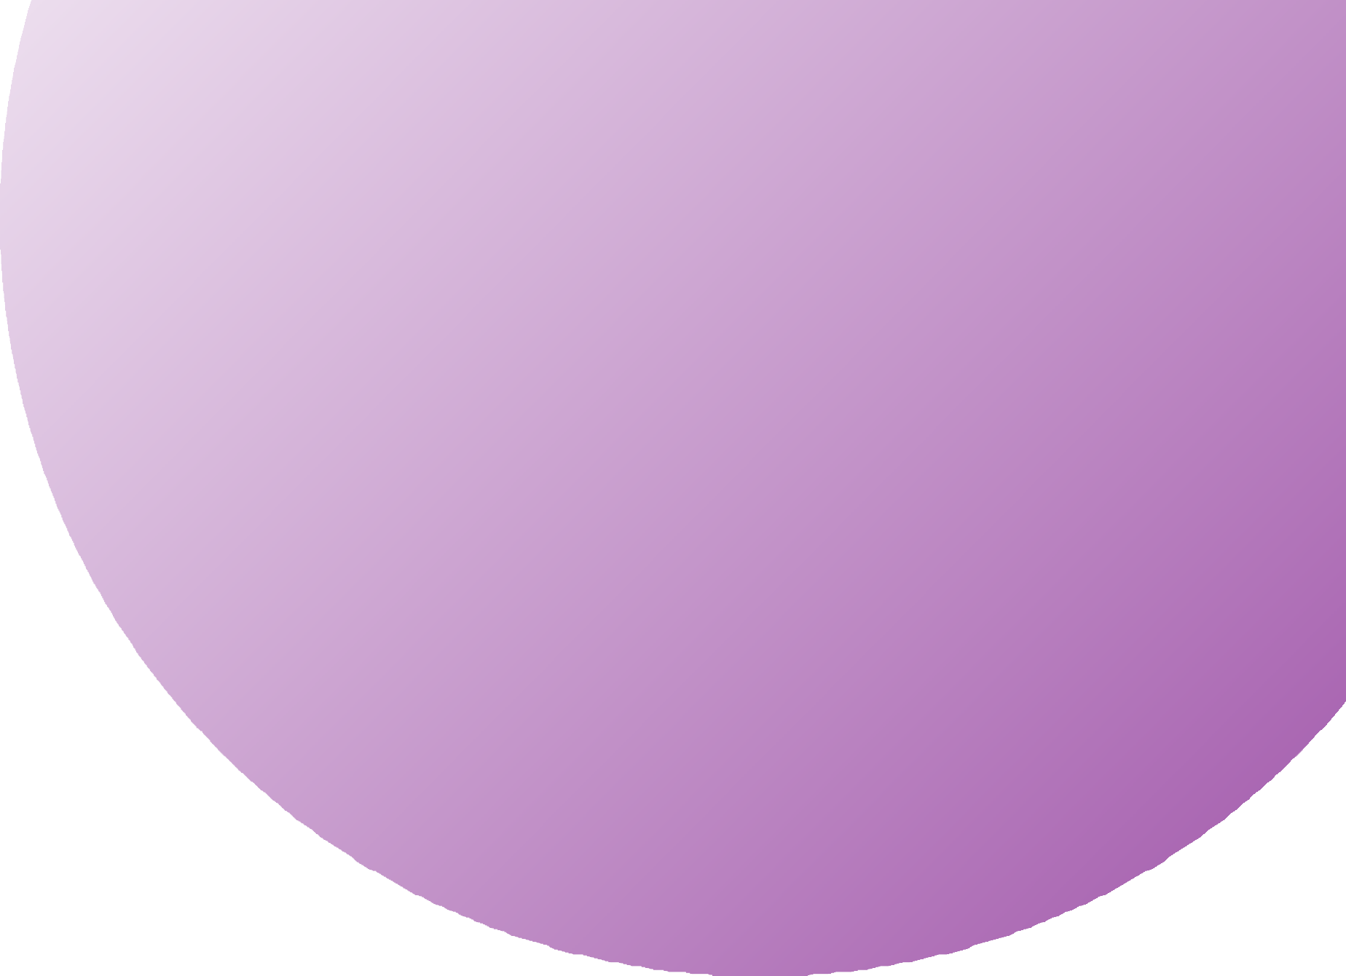
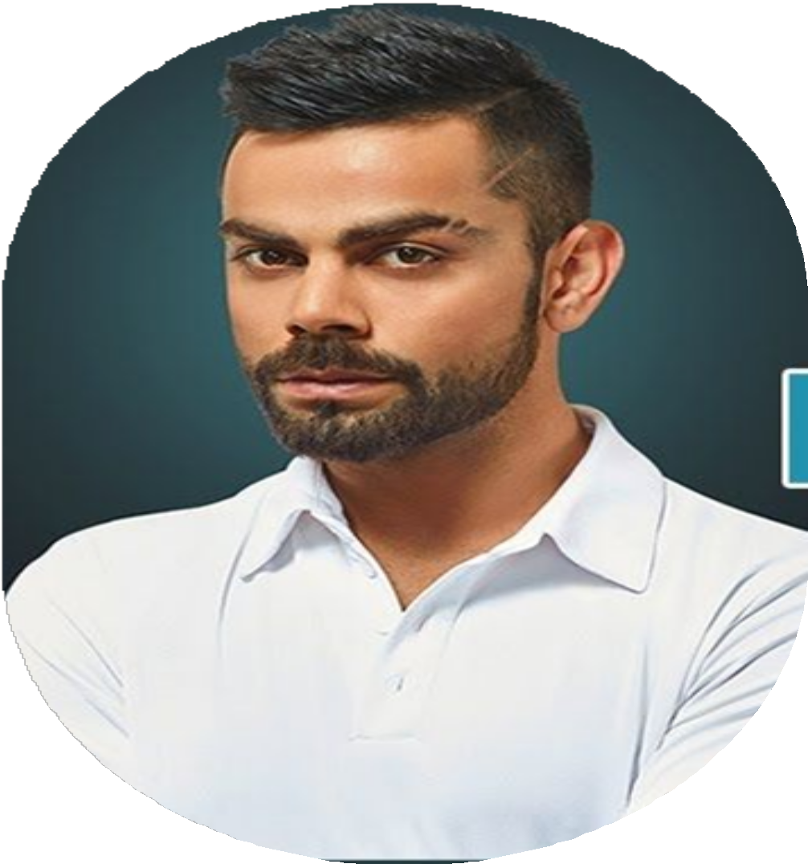
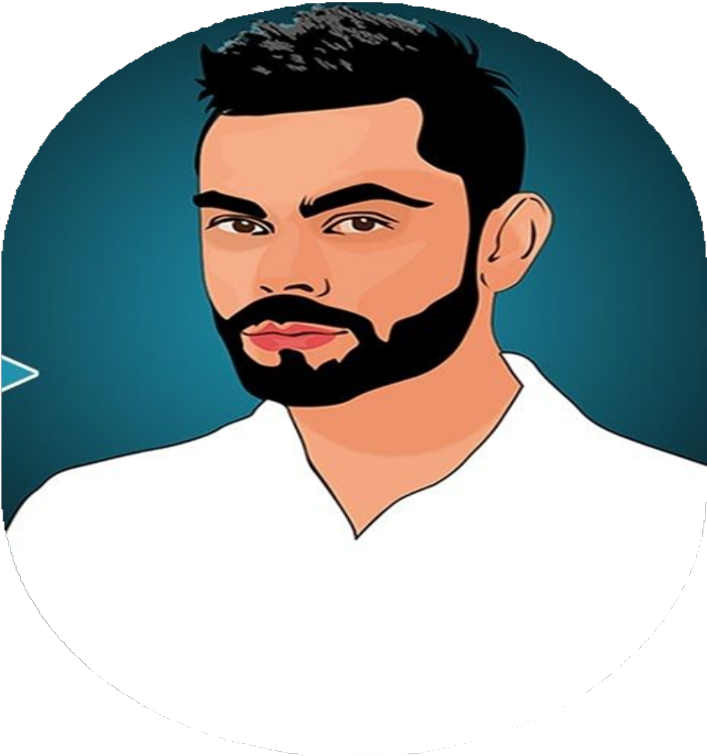

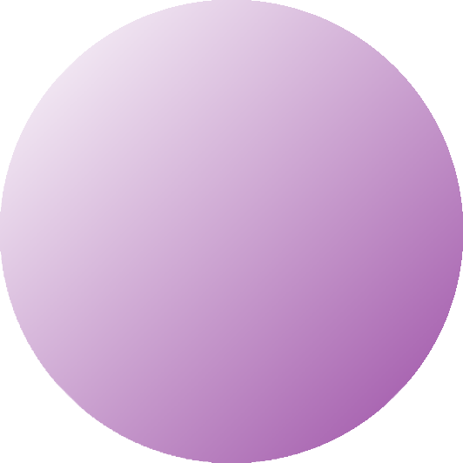

EXPECTED OUTCOME
INPUT
OUTPUT

Slide 13
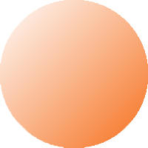
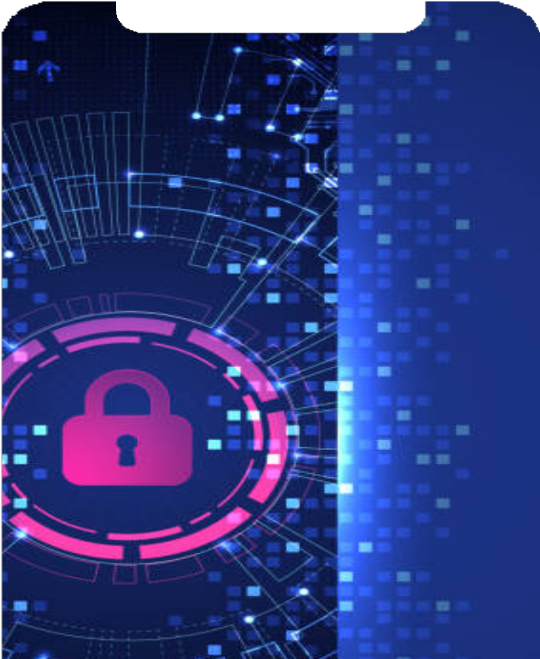

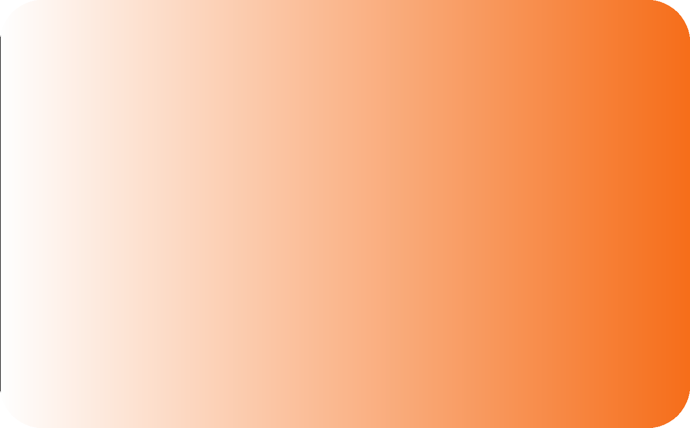
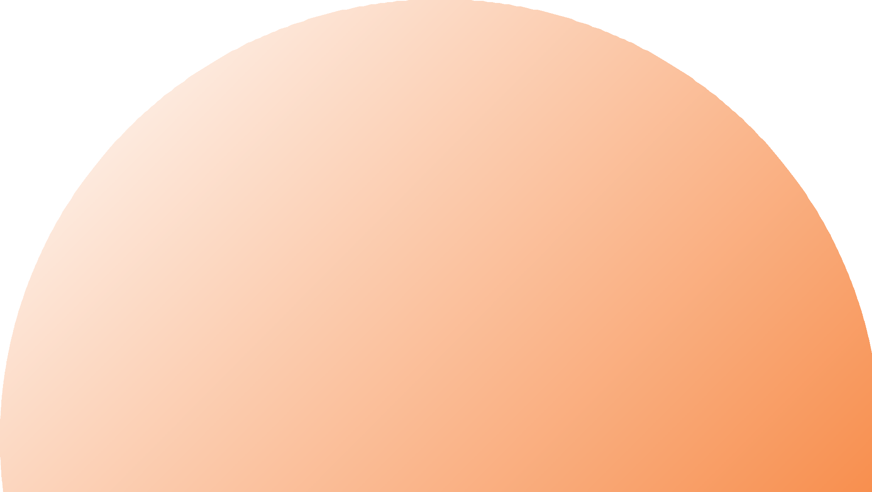
REFERENCES
https://www.analyticsvidhya.com/blog/ 2022/06/cartoonify-image-using- opencv-and-python/
https://data- flair.training/blogs/cartoonify-image- opencv-python/

Slide 14

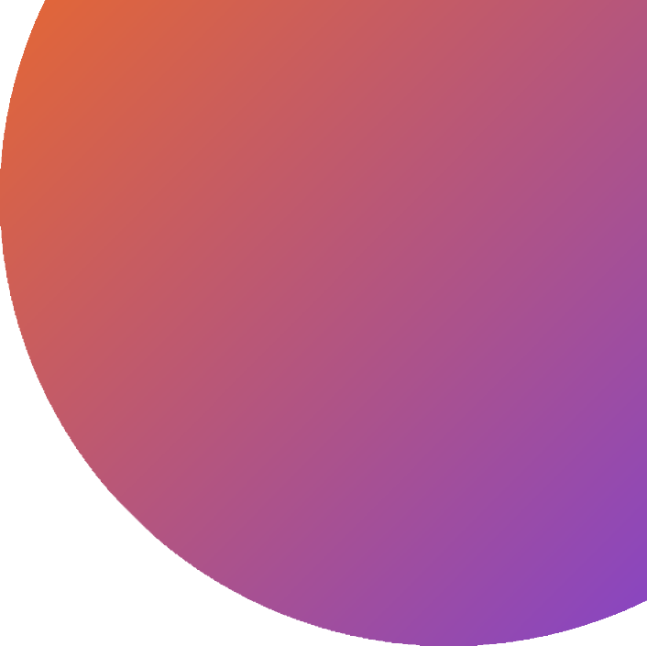
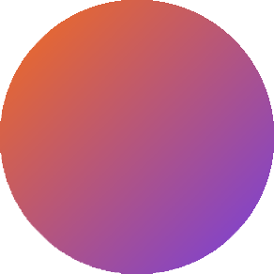
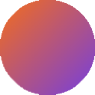
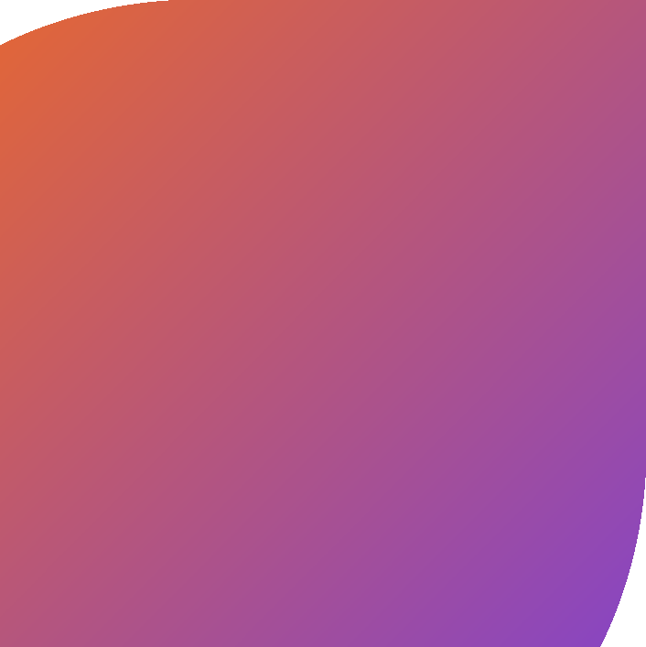

Thank
ou
MENTORED BY:
MS. SHREYA
PRESENTED BY : SIMPAL CHAURASIYA
VIKRANT SINGH SARANSH SINGH SUNDRAM JHA

